Slide 1
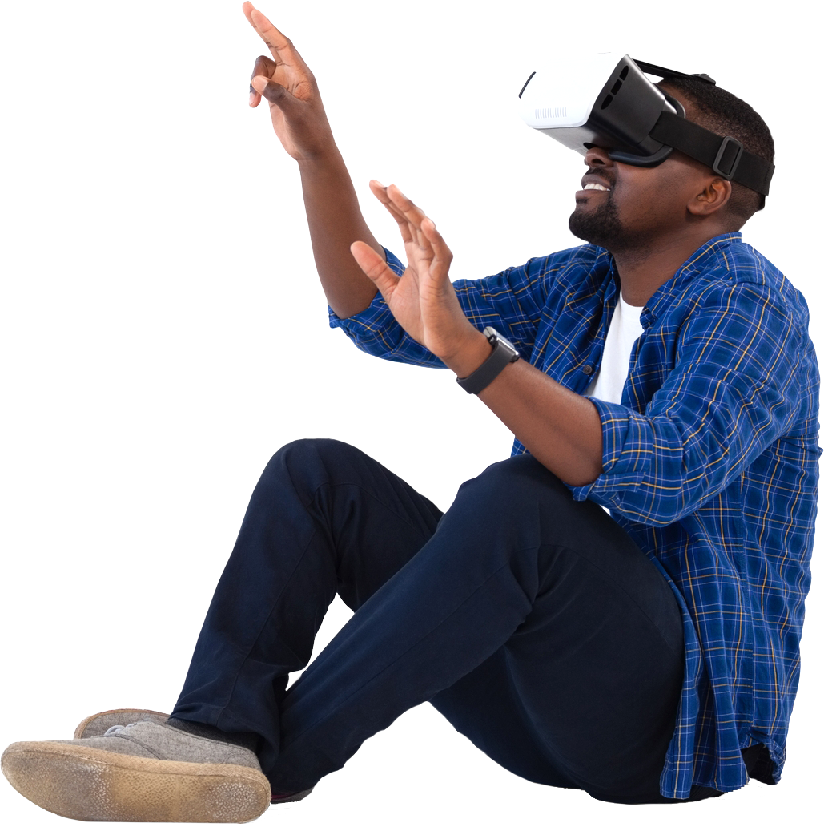
interactivity Pack
VR
Andrea Carver
January 13, 2018

Slide 2
Project Description
VR content creation tools lag behind the progress in VR hardware.
Problem: Without helpful tools, VR development is slow.
Solution: Create presets for the most common VR mechanics.
Target audience: Virtual reality developers using Unreal Engine.

Slide 3
User’s View
Integrates with game engine menus
To use, add one of the preset mechanics
To tweak, adjust the component attributes

Slide 5


Slide 6
GRIP

Slide 7
Motivation
Words

Slide 8
Questions?

